Slide 1

Automation Namespace
By Devul Nahar
Notes:
Automate your UI using Microsoft Automation Framework - CodeProject

Slide 2
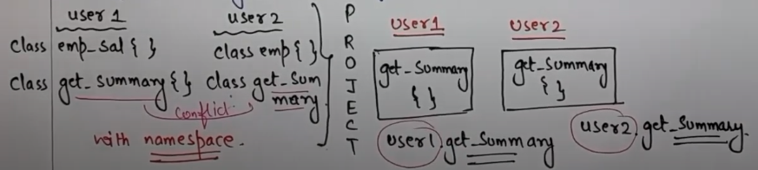
What are Namespaces?
Namespaces are used to organize classes, interfaces, structures, or methods.
Namespaces allow us to break up our code so that they can be easier to understand and maintain.
To access class, use using namespace.classname
Example: System.console.writeline (namespace, class, method)
The namespaces in C# can be nested. That means one namespace can contain other namespaces also.
Standard namespaces include: System, System.Net, System.IO. The user can also define their own namespaces
The namespace elements can't be explicitly declared as private or protected. The namespace allows only public and internal elements (elements in same assembly) as its members. The default is internal.
Helps in resolving class name conflicts

Slide 3
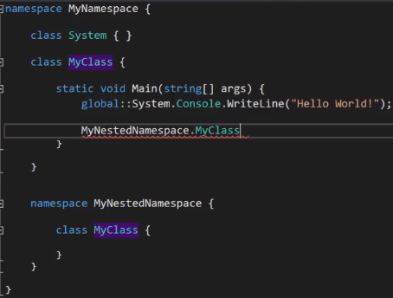

Slide 4
What is it the Windows Automation Namespace?
UI automation is a WPF programmatic interface to the user interface of your application to external applications that may be interested in programmatic communication with your UI. Through this you can access your UI’s button, and other visual/graphic elements from code.
UI automation testing is a technique where these testing processes are performed using an automation tool. Instead of having testers click through the application to verify data and action flows visually, test scripts are written for each test case.
UI Automation has several benefits:
Accessibility features – UI automation provides accessibility support in your application.
Automated UI testing – UI automation can automate testing for application UI saving time and costs associated with manual and regression testing. Moreover given a set of use cases, UI automation can be used to verify application behavior via scenario tests.
Custom controls – If you are authoring custom controls, UI automation support enables end clients of your control to automate your control in their application UI.

Slide 5
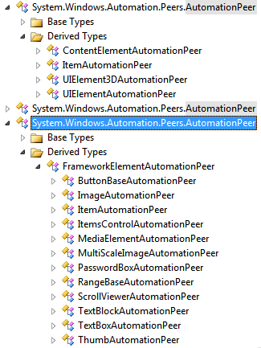
How does Automation Work?
Common protocol → for exchanging information between your application and an external entity such as screen reader or automated UI tests.
API → external application can discover controls, navigate the visual tree, access the state of the controls and perform control specific actions.
In WPF, automation object model is provided via System.Windows.Automation.AutomationElement instance associated with a UIElement (said to be “automation peer” of the control).
To support UI automation, a control author needs to implement an abstract class AutomationPeer from UIElement class’ virtual method OnCreateAutomationPeer.
AutomationPeer is then used at runtime to extract AutomationElement for the UIElement. It is important to note that the standard controls in WPF have standard implementation of AutomationPeer associated with the controls out of the box.
If you are authoring a custom control, you may want to implement one or more interfaces defined under the System.Windows.Automation.Provider namespace to support UI automation

Slide 6
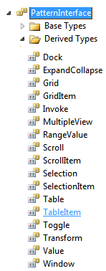
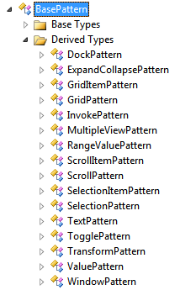
PatternInterface & AutomationPeer
Each AutomationPeer must implement one or more “standard control patterns” to expose capabilities that can be used by automation clients such as screen readers.
You can get a control for a specific PatternInterface via AutomationPeer’s GetPattern method that takes PatternInterface member as a parameter and returns the supported pattern or null if the specified PatternInterface is a not supported pattern.
For example, Button, Hyperlink and MenuItem controls support InvokePattern and can therefore indicate to the automation clients that control is capable of invoking a command.
Control patterns are strictly limited and custom control patterns are not supported. The reason is that automation clients must work on a standardized protocol and cannot interpret custom patterns to figure out the functionality of the controls.

Slide 7
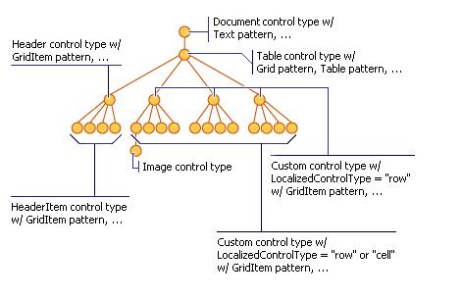
Automation Tree in WPF
Automation tree is constructed during automation tree navigation. One can navigate UI automation tree using the AutomationElement instance. There are multiple ways to view the automation tree:
RawViewWalker - non-filtered complete automation tree view
ControlViewWalker - a subset of raw view that only contains AutomationElements that correspond to controls
ContentViewWalker - a subset of control view that only contains AutomationElements that correspond to elements that represent information in terms of content to the end user
CustomView - Using an AutomationElement and a condition (which can be one of PropertyCondition, AndCondition, OrCondition or NotCondition), one can navigate automation tree in a custom manner. To navigate a custom view, a call to the FirstFind or FindAll methods of AutomationElement is made with a tree scope

